Slide 1





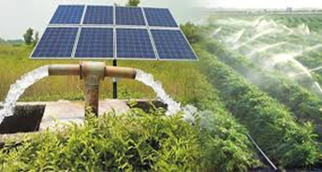
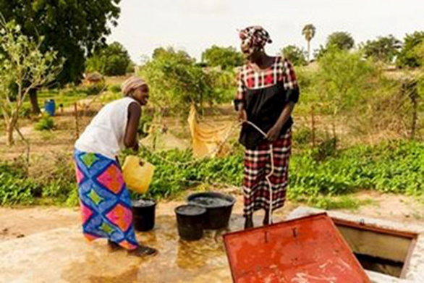
RÉPUBLIQUE DU SÉNÉGAL
Un Peuple – Un But – Une Foi
KICK-OFF MEETING DU 9E FORUM MONDIAL – DAKAR 2021
FAO RURAL DEVELOPMENT THEMATIC ISSUE CONCEPT NOTE
Water as a Catalyst for Rural Economic Development
Eugene Rurangwa, Land & Water Officer, FAO/SFW

Slide 2
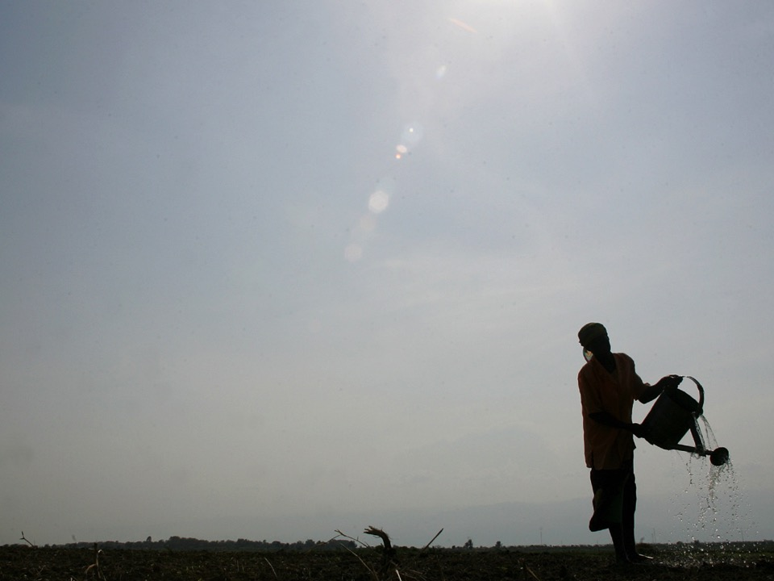
Introduction
Water is life. Without water, life is hopeless ; Water is essential for agricultural production and food security.
It is the lifeblood of ecosystems on which the food and
nutritional security of present and future generations
depends.
Water of appropriate quality and quantity is essential for drinking and sanitary purposes and for food production (fisheries, crops, livestock and forestry),
processing and preparation. Water is essential for
Heathy life and well being
Water is also important for the energy, industry
and other economic sectors.
Overall, water supports economic growth and
income generation.
Notes:
48 Results:
23 Global
4 Regional
21 Country Level

Slide 3

Water resources in Africa
Africa’s renewable water resources (3930 km³/yr) comprise less than 9% of the estimated total global renewable resources.
About 85% (184 km³/yr) of Africa’s water withdrawals are for agriculture.
Average annual precipitation is about 678 mm, ranging from 51 to 3200 mm/yr.
With less than 1% of Africa’s total renewable water resources, North Africa is the driest region,
With 48%, Central Africa is the wettest region.
Africa has 18 water basins, nine of which are shared (international) river basins: the Congo (providing 23% or 9.8 million ha), the Nile (19%, or 8 million ha), and the West basins (15% or 6.3 million ha) of the Africa’s total irrigation potential.
Kick-off meeting du 9e Forum Mondial de l’Eau, Dakar les 20 et 21 juin 2019

Slide 4
Water security varies with region: in South Africa, the challenge is distribution and storage; in the north, west, the Sahel and the horn of Africa it is scarcity.
In Africa, only 7%of arable land is irrigated; with 4% in SSA
93% of farmers in Africa rely on rainfed agriculture for their livelihoods
Yet, agricultural growth is key to reducing poverty and driving economic development
Africa is well endowed with water resources, yet water withdrawals are less than 3% of the total renewable resources
Additional investment in agriculture water management would pay great dividends
www.fao.org/agwa
Kick-off meeting du 9e Forum Mondial de l’Eau, Dakar les 20 et 21 juin 2019

Slide 5
Water withdrawals at global level
Globally, agriculture accounts for 70% of water withdrawals
Kick-off meeting du 9e Forum Mondial de l’Eau, Dakar les 20 et 21 juin 2019

Slide 6
Projected Impacts of Climate Change in Africa
Kick-off meeting du 9e Forum Mondial de l’Eau, Dakar les 20 et 21 juin 2019

Slide 7
Why water scarcity happens?
How people are affected? 1-Physical water scarcity 2-Lack of infrastructure (lack of investment) 3-Weak governance related to water resources | How to act? Country-focused Knowledge management and information sharing Applying principles of good governance Promoting investment and innovation
Kick-off meeting du 9e Forum Mondial de l’Eau, Dakar les 20 et 21 juin 2019

Slide 8
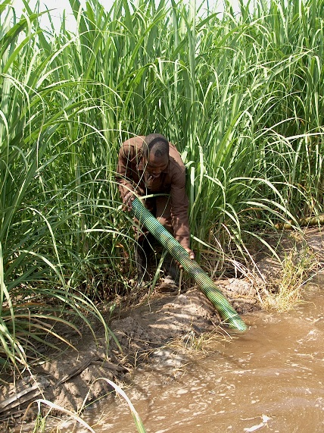
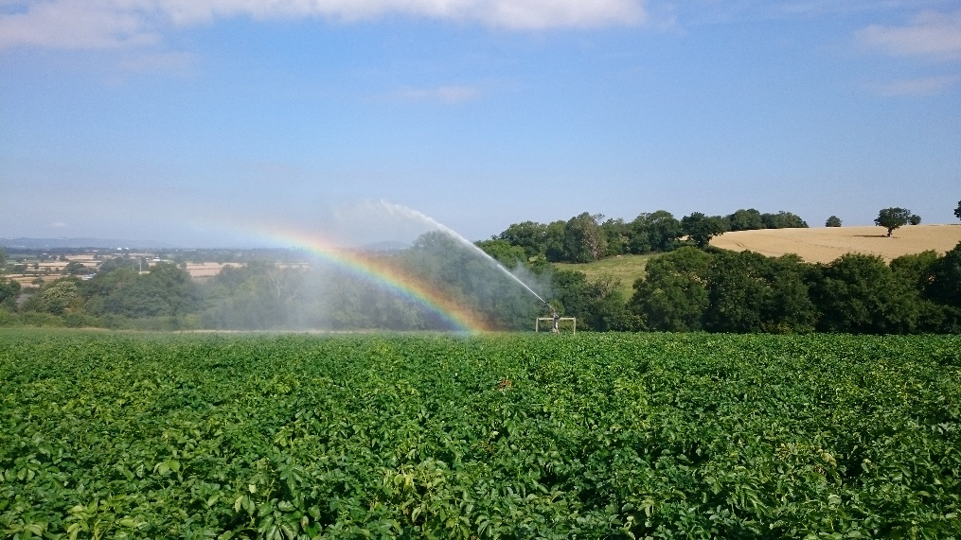
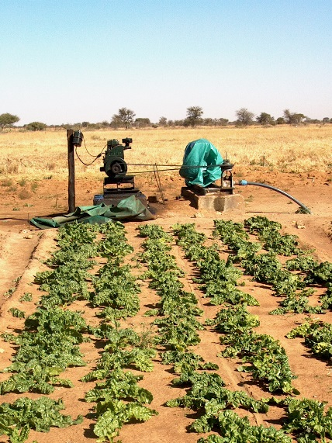
Future importance of irrigated agriculture
Food production must increase significantly by 2050 to meet the demand of the world’s growing population (UN, 2009)
60% of the extra food requirement in the future should come from irrigated agriculture (FAO, 1996, World Food Summit)
Kick-off meeting du 9e Forum Mondial de l’Eau, Dakar les 20 et 21 juin 2019

Slide 9
Setting the Stage: Philosophy and approach in Africa
Kick-off meeting du 9e Forum Mondial de l’Eau, Dakar les 20 et 21 juin 2019

Slide 10
RÉPUBLIQUE DU SÉNÉGAL
Un Peuple – Un But – Une Foi
Je vous remercie

