Slide 1




RÉPUBLIQUE DU SÉNÉGAL
Un Peuple – Un But – Une Foi
Kick-off meeting du 9e Forum Mondial de l’eau, dakar 2021
Priority 4 : means and tools
Contribution AfDB – UNESCO – WGI/OECD
DAKAR, le 20 juin 2019

Slide 2

Clarification to avoid overlap with other priorities
International governance: overall Forum issue?
Transboundary issues: priority 3?
Governance of humanitarian crisis: priority 1?
Kick-off meeting du 9e Forum Mondial de l’Eau, Dakar les 20 et 21 juin 2019

Slide 3
Nine major “governance” challenges to address in WWF9
Institutional framework
  Multiscale approaches (vertical coordination)
  Multisectoral approaches (horizontal coordination)
  Capacity development
  Acting local
Financing: What should be financed? How? Where are the gaps?
Trust and engagement
  Conciliation and respect as a condition for stakeholder engagement
  Trust/transparency
Sciences, technology and innovation (STI)
  Knowledge
  Innovation
Kick-off meeting du 9e Forum Mondial de l’Eau, Dakar les 20 et 21 juin 2019

Slide 4
Major challenge:
Shift from BAU policies to adequate framework and practices that mobilise energies and foster the implementation of solutions
Sustainability Declaration closing the 8th Word Water Forum (Brasilia – 2018):
“Progress in water management is not only an objective per se, but also a pivotal contribution to the global success of most Sustainable Development Goals (SDG) of the 2030 Agenda for Sustainable Development (ASD).[…]
We consider that current water policies will not be sufficient to reach the targets of the Sustainable Development Goals (SDGs)[…]
We, together, must commit to the implementation of good practices […] as well as a drastic improvement of water governance […]
Efforts remain to be accomplished beyond the water sector to develop holistic policies and avoid fragmented approaches.”
Kick-off meeting du 9e Forum Mondial de l’Eau, Dakar les 20 et 21 juin 2019

Slide 5
Major challenge: finance. What should be financed? How? Where are the gaps?
Initiated by the Camdessus panel, WWF3… Wimpenny & al. WWF7-8… high level panel WWF8
Inadequate prioritization of water security in national development plans. Huge investment gaps: $1.7 trillion est. cost to meet SDGs for WSS services, three times more than invested to date. Similar diag. in hydropower, agriculture, flood mitigation…
Critical mismatch for promoting innovative financing mechanisms:
  Affordability constraints at household level.
  Limited availability of funds for domestic operators and Small scale water service providers.
  Risk profile and difficulties in risk management.
  Lack of funds at decentralised, regional and transboundary levels.
  Under-capitalized balance sheets.
  Lack of understanding of the sector by external lenders and investors.
  Lack of “bankable” projects” at all levels.
Kick-off meeting du 9e Forum Mondial de l’Eau, Dakar les 20 et 21 juin 2019

Slide 6
Major challenge: Sciences, Technologies and Innovation.
Topic initiated at WWF7 (« Sciences and Technologies Process »)
Collecting data and deriving information
Bridging the science-policy interface
Adapting capacity-building activities
Integrating indigenous knowledge
Kick-off meeting du 9e Forum Mondial de l’Eau, Dakar les 20 et 21 juin 2019

Slide 7
The Water Governance Initiative considers Dakar 2021 as a major milestone
Launched after WWF6
Mobilizes 140+ stakeholders
Supported by OECD
12 Principles in 2015 for WWF7
Indicators and methodology delivered in WWF8
Program currently under discussion in plenary meeting in Berlin
a web-based “Water Governance Capacity Development Lab”
Regional survey on water governance in Africa; three policy dialogues at different scales; and a repository of solutions
New steps in indicators
Steering committee
Kick-off meeting du 9e Forum Mondial de l’Eau, Dakar les 20 et 21 juin 2019

Slide 8
Example of potential results: finance
Innovative mechanisms to finance the water sector development and associated implementation modalities.
Conditions to create enabling environments and capacities to increase funding in the water sector.
Potential regional and/or country assessment and reporting on funding needs, mechanisms and roadmaps.
Kick-off meeting du 9e Forum Mondial de l’Eau, Dakar les 20 et 21 juin 2019

Slide 9
Example of potential results: launch of water governance capacity development Lab in 2021 – WGI
Kick-off meeting du 9e Forum Mondial de l’Eau, Dakar les 20 et 21 juin 2019

Slide 10
Example of potential results: New steps in indicators and methodology
Revisiting the 11 pilot tests;
Developing impact indicators to complement OECD Water Governance Indicator Framework;
Providing guidance for multi-level governance engagement for water-related SDGs monitoring, using the ten-step assessment developed together w/OECD Water Governance Indicator Framework.
Kick-off meeting du 9e Forum Mondial de l’Eau, Dakar les 20 et 21 juin 2019

Slide 11
Ideas to renew the Forum
(to coordinate with Dakar2021 initiative and other priorities)
Sessions: take stock of progress, discuss gaps to achieve the goals, methodologies.
Masterclasses: a few cases with 3x1h sessions.
Fish-bowl conversations (“palabre”): to commit ourselves and build consensus for further steps.
Challenges: short show case studies organised thematically, to take stock of lessons learned
Marketplace: space to build partnerships.
Kick-off meeting du 9e Forum Mondial de l’Eau, Dakar les 20 et 21 juin 2019

Slide 12
Preparatory process: key milestone meetings
WGI plenaries: November 2019, June 2020 and November 2020
ANBO General Assembly, Tunisia, July 2019;
INBO General assembly, Morocco, October 2019;
COP 25 Climate, Chile, November 2019;
XVII World Water Congress, Korea, May 2020;
23rd IHP Intergovernmental Council, France, June 2020;
COP15 Biodiversity, China, June 2020;
Stockholm World Water Week, Sweden, August 2020;
10th GEF Biennial International Waters Conference.
Kick-off meeting du 9e Forum Mondial de l’Eau, Dakar les 20 et 21 juin 2019

Slide 13
Next short term steps
KoM : enriches the proposal
Priority team: finalizes the proposal
ISC: decides main lines of the organization
Priority team: provides detailed mapping of events for the forum and agenda of activities
Kick-off meeting du 9e Forum Mondial de l’Eau, Dakar les 20 et 21 juin 2019

Slide 14
Priorité 4 - Outils & Moyens
Thème 3 - Gestion des connaissances et innovation
Youssef Filali-Meknassi
Kick-off meeting - WWF9
Dakar – 18 juin 2019
Kick-off meeting du 9e Forum Mondial de l’Eau, Dakar les 20 et 21 juin 2019

Slide 15

Kick-off meeting du 9e Forum Mondial de l’Eau, Dakar les 20 et 21 juin 2019

Slide 16
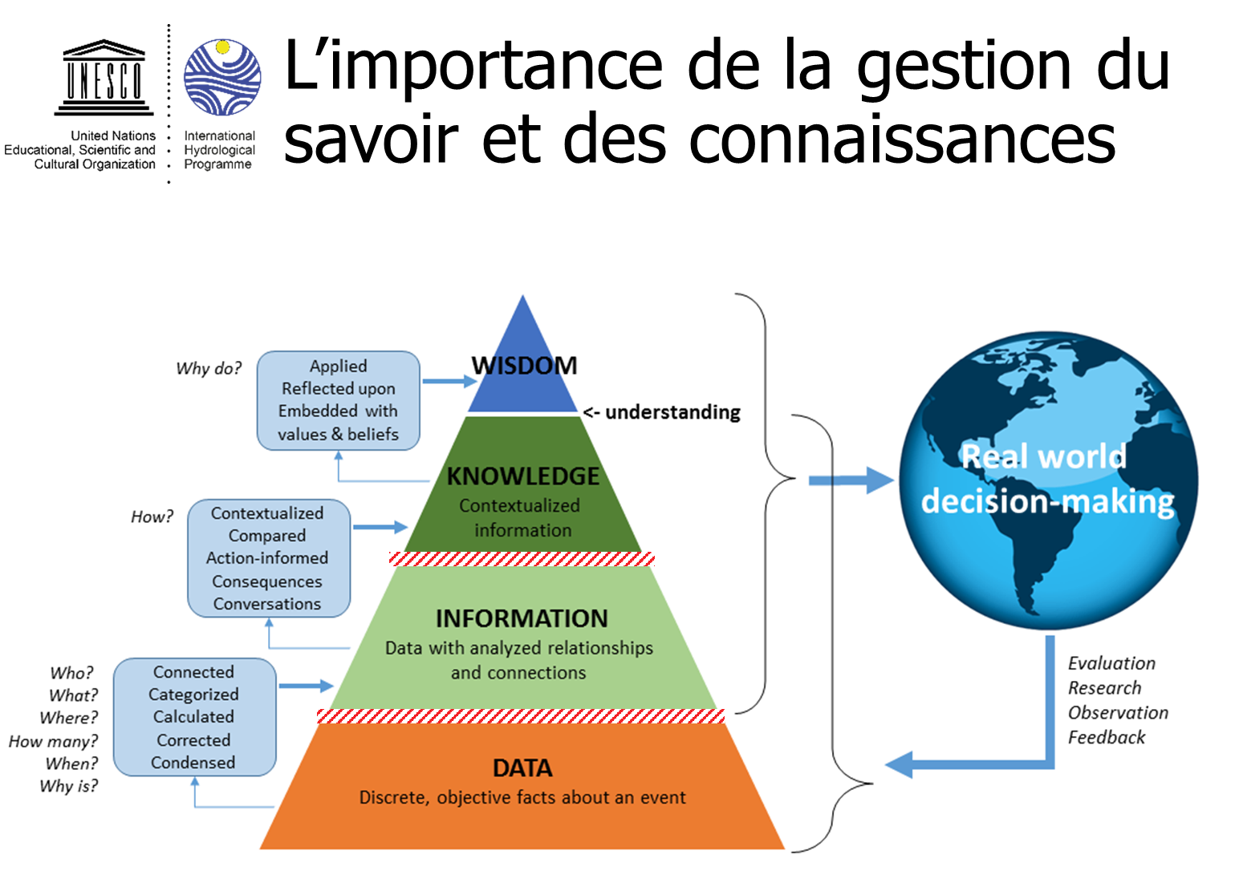
Kick-off meeting du 9e Forum Mondial de l’Eau, Dakar les 20 et 21 juin 2019

Slide 17

Kick-off meeting du 9e Forum Mondial de l’Eau, Dakar les 20 et 21 juin 2019

Slide 18
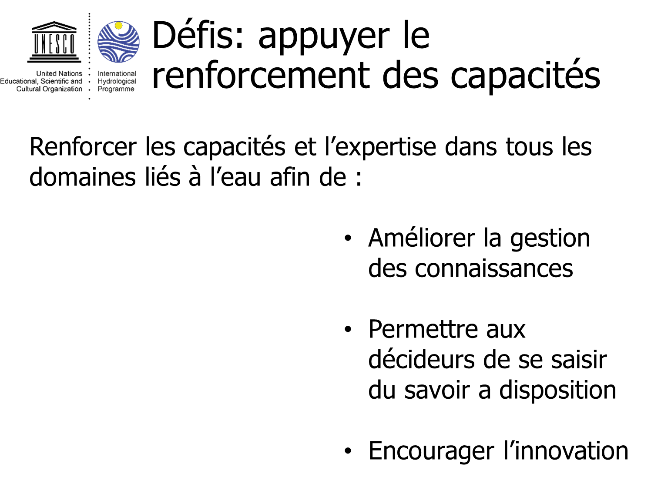
Kick-off meeting du 9e Forum Mondial de l’Eau, Dakar les 20 et 21 juin 2019

Slide 19

Kick-off meeting du 9e Forum Mondial de l’Eau, Dakar les 20 et 21 juin 2019

Slide 20

Kick-off meeting du 9e Forum Mondial de l’Eau, Dakar les 20 et 21 juin 2019

Slide 21
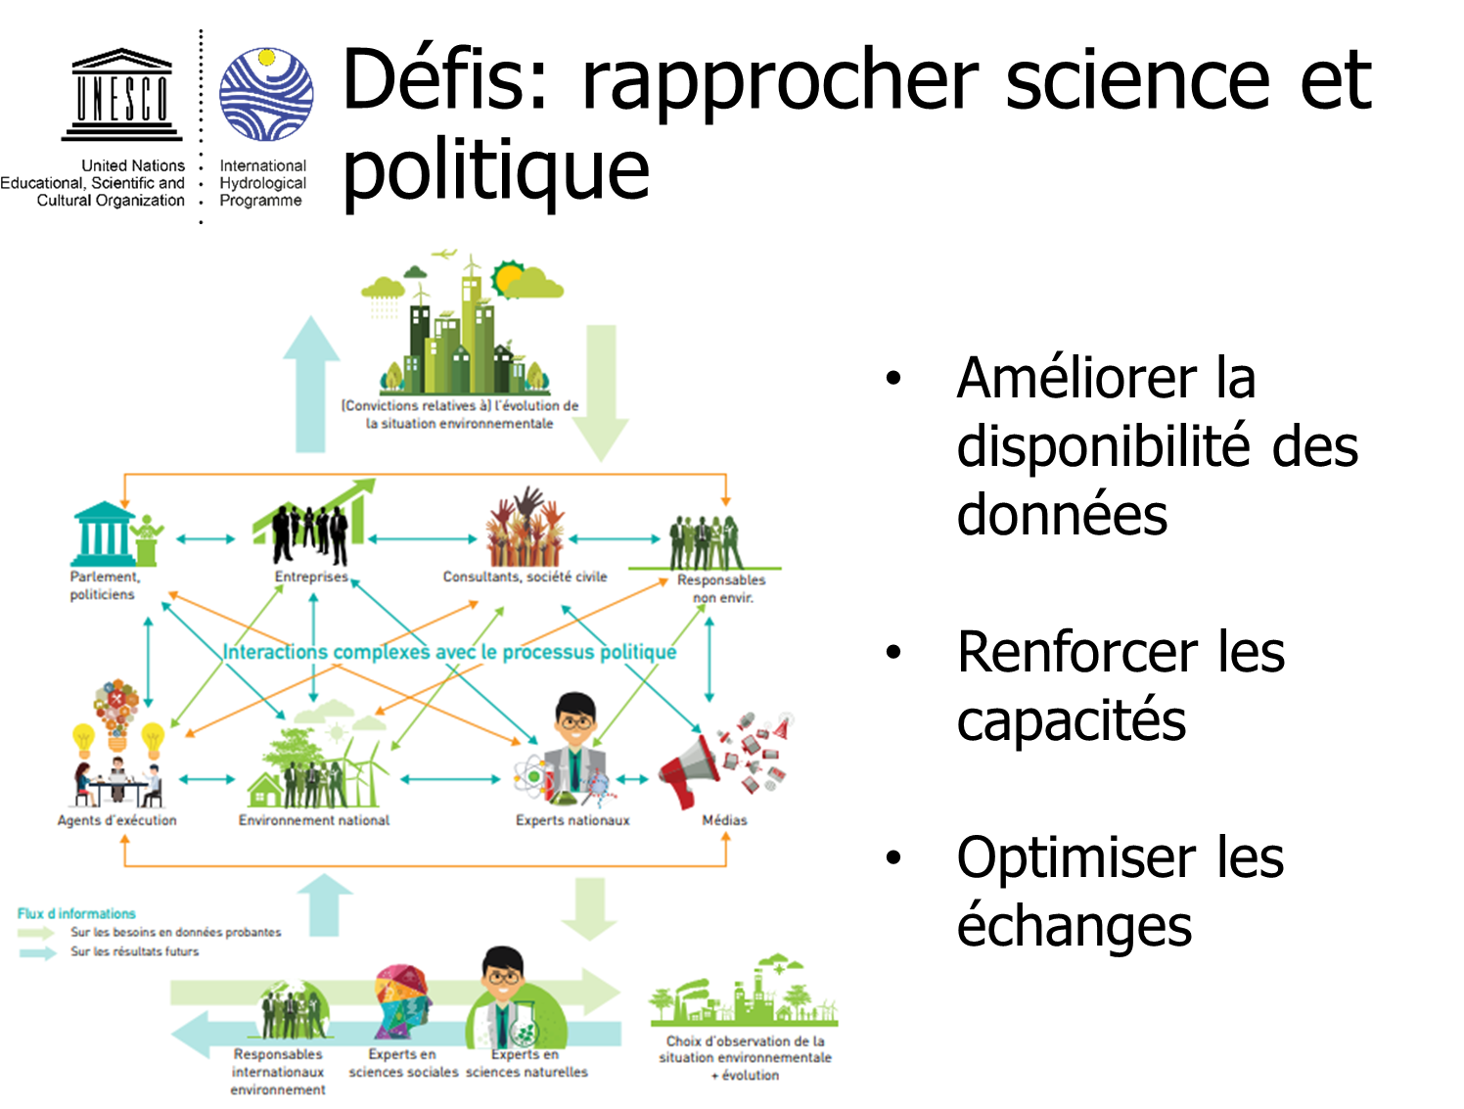
Kick-off meeting du 9e Forum Mondial de l’Eau, Dakar les 20 et 21 juin 2019

Slide 22
RÉPUBLIQUE DU SÉNÉGAL
Un Peuple – Un But – Une Foi
Je vous remercie

