Slide 1
RÉPUBLIQUE DU SÉNÉGAL
Un Peuple – Un But – Une Foi
Kick-off meeting du 9e Forum Mondial de l’eau, dakar 2021
Water Security Priority
Callum Clench (IWRA) & Jean Bosco Bazie (Eau Vive)
E-mails: c.clench@iwra.org
jbbazie@eau-vive.org
DAKAR, le 20 juin 2019

Slide 2
1- Which are the 3 most important issues that should be addressed by this Priority?

Slide 3
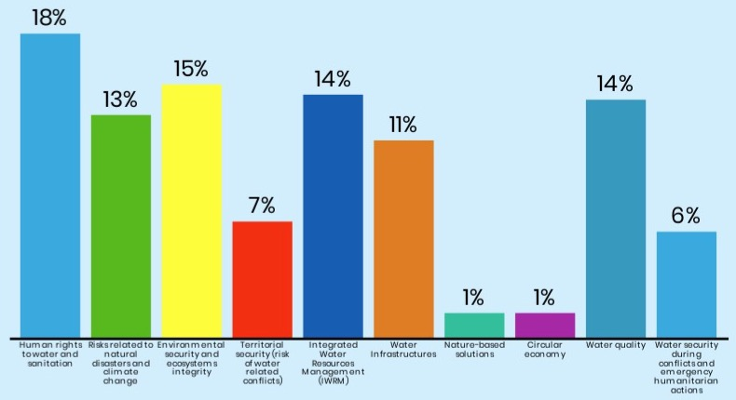
Results according to the POle
Other Issues:
-WEF Nexus;
-Water in Cities;
-Sanitation;
-Governance &
Diplomacy;
-Water-borne
Diseases;
-Water Pricing;
-Financing;
-Transboundary
Conflicts;
etc.
Kick-off meeting du 9e Forum Mondial de l’Eau, Dakar les 20 et 21 juin 2019
Notes:
1 – Human rights to water and sanitation 18%
2 – Environmental security and ecosystems integrity 15%
3 – Water quality 14%
4 – Integrated Water Resources Management (IWRM) 14%

Slide 4
The most popular topics were
1 – Human rights to water and sanitation (18%)
2 – Environmental security and ecosystems integrity (15%)
3 = Water quality (14%)
3 = Integrated Water Resources Management (IWRM) (14%)
Kick-off meeting du 9e Forum Mondial de l’Eau, Dakar les 20 et 21 juin 2019

Slide 5
2- What concrete outcomes will enable progress on these 3 issues by 2021 and/or after (initiatives to be launched during the forum)?
Notes:
Note that there overlap between these issues, and often the outcomes refer to other issues not in the top 4. It was also noted that there is no “one size fits all” solution.

Slide 6
Access to water and sanitation (Part 1)
Ensuring universal access to safe water and sanitation, in national constitutions and enforced through legislation
Providing access to safe water and sanitation in emergency situations
Integrating the right to water and sanitation in development programmes
Developing a list of concrete actions that can improve rights, especially in the Sahel region
Supporting the delivery and monitoring of progress towards SDG 6
Kick-off meeting du 9e Forum Mondial de l’Eau, Dakar les 20 et 21 juin 2019

Slide 7
Access to water and sanitation (Part 2)
UN Conference on Water – encourage states through a declaration to adopt the SDG indicators
Local appropriation/solutions with a long-term focus
Include civil society in all processes, supporting inclusive and participatory water resource management wherever possible
Transboundary convention on the right to access water resources during times of conflict
Kick-off meeting du 9e Forum Mondial de l’Eau, Dakar les 20 et 21 juin 2019

Slide 8
Environmental security and ecosystems integrity
Integrating green and grey infrastructure, as good infrastructure improves everything else
Ensuring sufficient environmental flows
Developing sustainable solutions for both human communities and the ecosystems that support them
Kick-off meeting du 9e Forum Mondial de l’Eau, Dakar les 20 et 21 juin 2019

Slide 9
Water Quality
Gain commitments for the prioritisation of finance for water infrastructure
Water Infrastructure programmes launched
Share knowledge on how to improve data acquisition
Define the norms for water quality
Improve water information systems and knowledge of the resource by supporting monitoring at basin level
o Know the sources of pollution and initiate clean-up actions and develop low/non-polluting solutions
Kick-off meeting du 9e Forum Mondial de l’Eau, Dakar les 20 et 21 juin 2019

Slide 10
Integrated Water Resources Management (IWRM)
Gain commitments to develop plans and support for cities to be better connected to their basins
Gain commitments that water is included in climate change adaption plans and their financing
Develop implementation plans at both local, national and basin levels
Know the sources of pollution and initiate clean-up actions and develop low/non-polluting solutions
Kick-off meeting du 9e Forum Mondial de l’Eau, Dakar les 20 et 21 juin 2019

Slide 11
3- Which type of organizations or institutions and stakeholders need to be involved in this priority, considering political, regional, citizen, & thematic perspectives?

Slide 12
Integrated Water Resources Management (IWRM)
Local communities and users who are on the front lines of water problems;
Local elected officials;
Parliamentarians;
Policy makers at the national level (Governments, administrations and state services, international organizations including the United Nations, etc.);
Financial decision-makers (funders, financial institutions, etc.);
The private sector;
Academics and research actors;
Opinion leaders and holders of cultural and historical knowledge
Kick-off meeting du 9e Forum Mondial de l’Eau, Dakar les 20 et 21 juin 2019

Slide 13
4- What events can be leverage in the coming 2 years to prepare the Forum across region, specific to this Priority??

Slide 14
A Long but noit an exhaustive list…
XVII World Water Congress on “Foundations for Global Water Security and Resilience: Knowledge, Technology and Policy”, Daegu, Korea, May 2020
World Water Week, Stockholm 2019 & 2020
General Assembly of International Network of Basin Organizations (INBO)
INBO General Assembly
Asia International Water Week, Bali, Indonesia, 2020
Nairobi Conference 2020
World Bank Spring Meetings
Conseils des ministres des organismes de basin
Sommet des Chefs d'Etat des communautés economiques regionals
Sommets du G5 Sahel
The 20th Congress of the African Water Association, Uganda 2020
General Assembly of African Network of Basin Organizations
Kick-off meeting du 9e Forum Mondial de l’Eau, Dakar les 20 et 21 juin 2019

Slide 15
A Long but noit an exhaustive list…
4th Mediterranean Water Forum, Malta, 2020
China Water Expo & China Water Symposium 2020 in Suzhou.
Cairo Water Week, November 2019
38th IAHR World Congress: 1 Sep 1-6, 2019. Panama City, Panama,
The 8th International Conference on Flood Management: 3 August 17 - 19, 2020. Iowa City, USA. "
World forum on circular economy in 2020
Singapore International Water Week
Finance Ministers Meeting and Sector Ministers Meeting of the "Sanitation and Water for All Partnership
G20 and G7 in France (finance ministers meeting)
Faecal Sludge Management 6 (FSM6) and SWA ministerial meetings
African Water Week – High Political Forum
UN general assembly
Regional meetings with core partners
Kick-off meeting du 9e Forum Mondial de l’Eau, Dakar les 20 et 21 juin 2019

Slide 16
A Long but noit an exhaustive list…
UNEP global water quality meeting in September 2019
COP 25
List all actors affected by this phenomenon, then try to raise awareness on the issue of water and sanitation and organize small meetings of exchanges to encourage them to take part in the problems related to water and sanitation.
Workshops and social-cultural events
Webinars and online discussions
Citizen hearings
Kick-off meeting du 9e Forum Mondial de l’Eau, Dakar les 20 et 21 juin 2019

Slide 17
Final Thoughts…

Slide 18
Let’s not forget…
We need to be clear about what we mean when we talk about Water Security
Risks related to natural disaster and climate change also scored highly ten
Infrastructure also scored highly, coming up often in discussions
There is overlap between themes, and some should be considered cross-cutting
While most of these issues are global, the solutions tend to be local
There is no “one size fits all” solution
As this Forum will be in Senegal, let’s not forget the Sahel region.
This discussion has only just begun and will continue…
Kick-off meeting du 9e Forum Mondial de l’Eau, Dakar les 20 et 21 juin 2019

Slide 19
RÉPUBLIQUE DU SÉNÉGAL
Un Peuple – Un But – Une Foi
Je vous remercie

